Slide 1
Online Prescriptions
Welcome to our Project

Slide 2
Prepared by
Kazi Muntasir Rahman.
Sohel Matubber.
Hakim Khan.

Slide 3
Description
We are constantly afflicted with some disease or the other and resort to doctors. It is very difficult to get a prescription for a patient after 1 to 2 years of visiting a doctor. Even, some patients lose their prescription within months of recovery. In most cases, an experienced doctor can guess the diseases to see the patient's previous prescription. So, a prescription is very important for the treatment of any subsequent diseases. To solve this problem, we are going to build a web application.

Slide 4
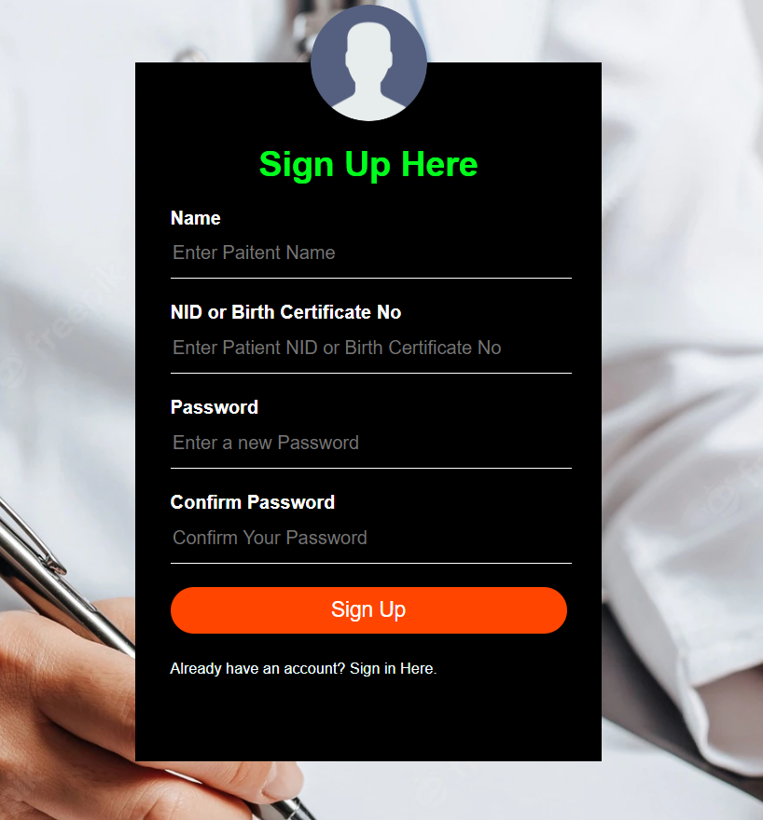
Steps
All information of a registered doctor like his name, qualifications, experience, institution, department, patient visiting schedule must be included in this application.
First a patient has to enter his identity info in this application.
His NID no will be the ID no of this application. For patient under 18, their birth certificate no will be the ID no.
When these patients (under 18) will get NID card, their ID no will convert into NID no.

Slide 5
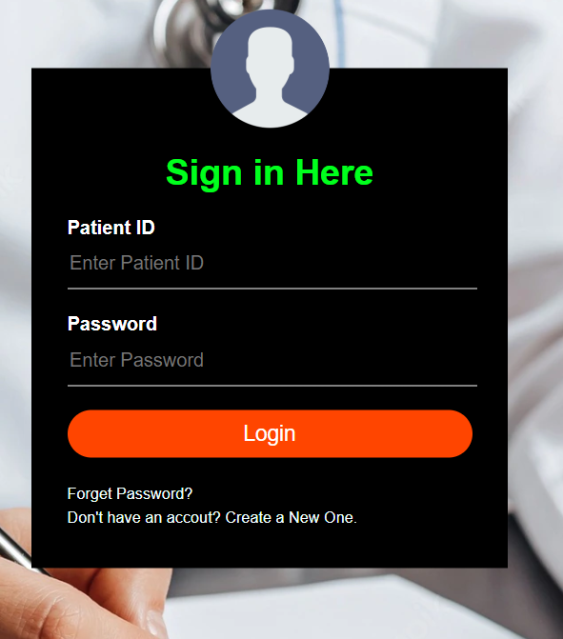
Steps
5. When a patient visits a doctor, the doctor must enter into the patient's ID and must include the result of report and medicines.
6. Only registered doctor can add info into it and can’t be updated by any party.

Slide 6
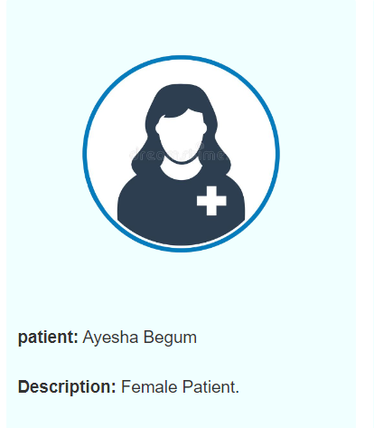
Steps
7. Now anyone with NID card no can see the details of patient.

Slide 7
Advantages
In no time anyone can know about all the previous diseases info of the patient.
This application will save the valuable time of the doctor as well as the patient.
A patient can find specific doctor for subsequent diseases within a moment with ease.
Patient don’t have to carry his previous prescriptions and report files.
Anyone can’t buy any medicine without registered approval doctor.

Slide 8
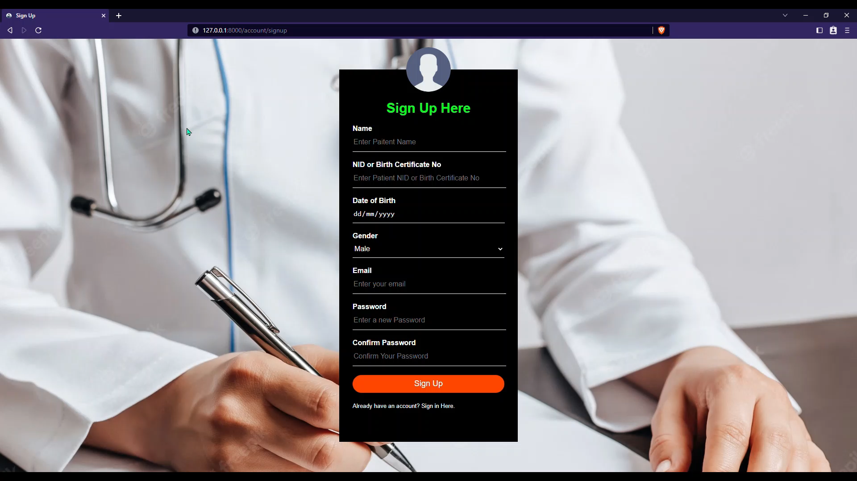

Slide 9
Thank You

